Slide 1














HACKCONQUEST
AETHER
HACKATHON
2026
ALIGNME
Real-Time Posture Monitoring & Correction

Slide 2
ALIGNME
TEAM NAME:
Tech Titans
LEADER NAME:
Mihir Kamat
COLLEGE NAME:
Thadomal Shahani Engineering College
IDEA / PROJECT TITLE:
AlignMe – Real-Time Posture Monitoring & Correction
THEME
Health, Productivity & Computer Vision
PROBLEM STATEMENT
Prolonged poor sitting posture often goes unnoticed during work or study. Users need timely, non-intrusive feedback to recognize and correct posture in real time.

Slide 3
PROBLEM STATEMENT & ROOT CAUSE
REAL-WORLD ISSUE
ROOT CAUSES & PAIN POINTS
People who spend long hours working or studying at a desk may gradually slip into poor sitting positions without noticing. Because the correction usually happens only after discomfort, unhealthy posture can become a repeated habit.
• Low awareness while concentrating on tasks
• Long, uninterrupted periods of sitting
• Slouching or leaning toward the screen
• No continuous posture feedback
• Users often notice the problem only after discomfort
Affected stakeholders
SHORTCOMINGS OF CURRENT APPROACHES
• Students
• Office / remote workers
• Frequent computer users
• Manual self-checks are easy to forget
• Periodic reminders do not verify actual posture

Slide 4
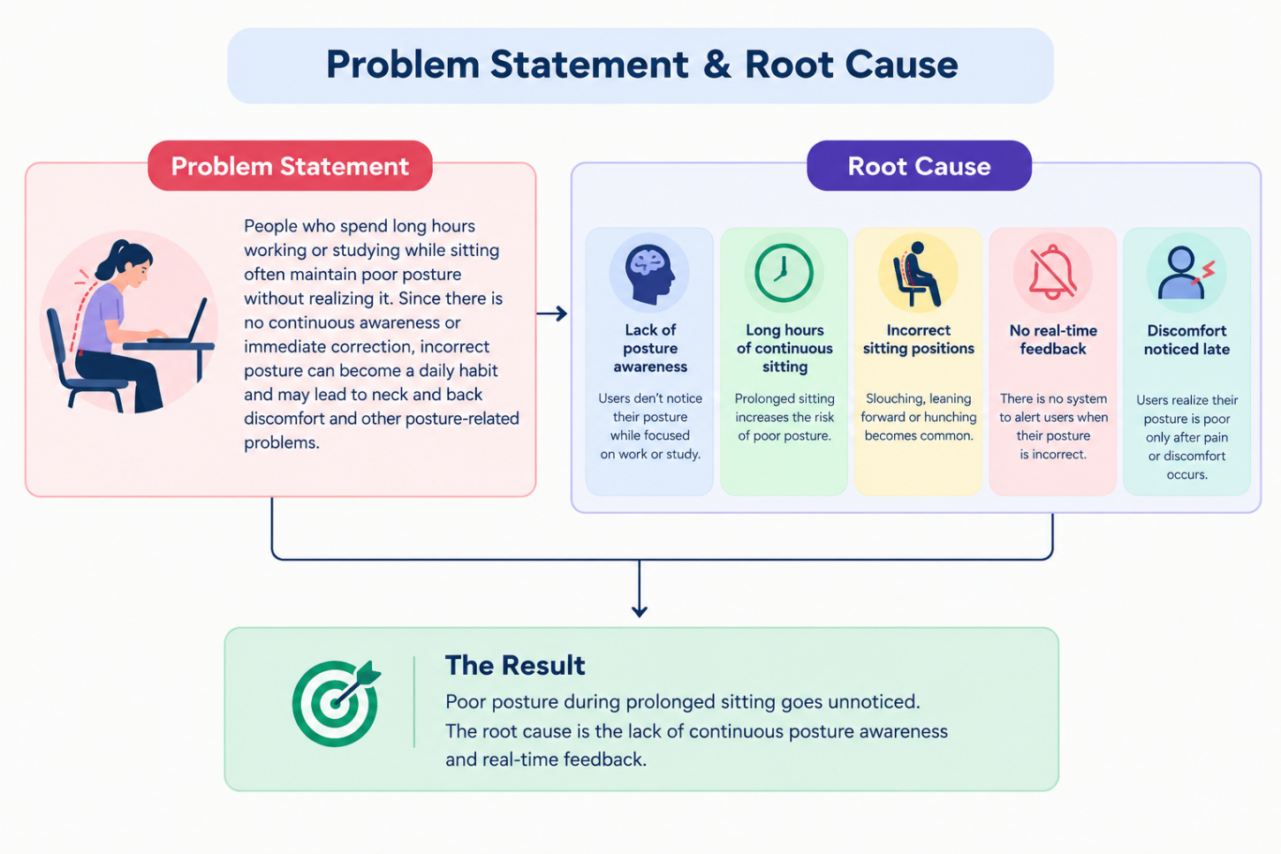

Slide 5
PROPOSED SOLUTION
HIGH-LEVEL CONCEPT & VALUE
DIFFERENTIATING FACTORS
AlignMe continuously observes the user's sitting posture through a webcam, checks body alignment, and gives immediate visual feedback when a posture needs correction.
• Continuous posture-aware feedback instead of generic timed reminders
• Focuses on actionable correction at the moment poor posture is detected
• Simple browser-first experience with minimal user effort
• Designed for students and desk-based workers
• Can evolve from basic posture checks to personalized guidance
Core value proposition
• Real-time awareness
• Non-intrusive correction
• Works during normal work/study sessions
Functional workflow
WEBCAM → POSE DATA → POSTURE CHECK → FEEDBACK

Slide 6
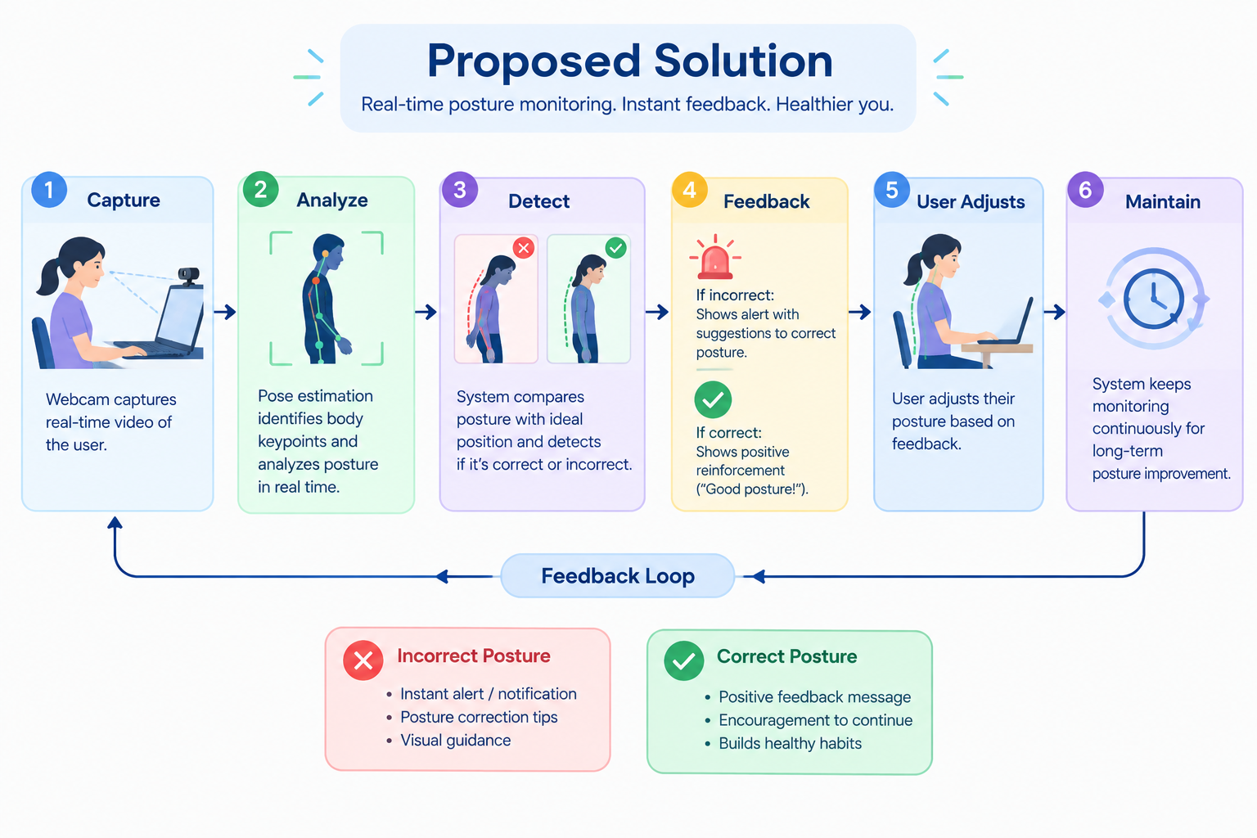

Slide 7
TECHNICAL ARCHITECTURE & METHODOLOGY
3
Webcam
Pose Estimation
Posture Analysis
4
END-TO-END SYSTEM FLOW
→
→
→
Feedback
Live camera frames
Body landmarks
Alignment rules / thresholds
Visual correction prompt
TECH STACK
METHODOLOGY
• React – responsive user interface and live feedback
• MediaPipe – real-time body/pose landmark detection
• TensorFlow.js – browser-based model inference and posture logic
• Webcam / browser APIs – camera input
• Capture frames from the webcam
• Extract body landmarks
• Calculate posture indicators
• Compare against defined posture conditions
• Trigger clear feedback when correction is needed

Slide 8
CORE USPs & COMPETITIVE ADVANTAGES
Zero-Knowledge Edge Privacy • Personalized Baseline Calibration • Zero False-Alarm Hysteresis
100% ZERO-KNOWLEDGE EDGE CV
Absolute Optical Privacy
• Zero Cloud Video Streaming: Raw webcam frames never leave the client device or traverse external servers, ensuring 100% HIPAA & GDPR compliance.
• In-Browser WASM Execution: Complete 33-point 3D anatomical skeletal extraction runs in WebAssembly with sub-10ms inference latency.
• Offline Resilience: Self-hosted local WASM binaries and TFLite neural models run smoothly without internet connectivity or CDN downtime.
• Enterprise B2B Ready: Safe for corporate-managed laptops in high-security finance, healthcare, and engineering environments.
PERSONALIZED CALIBRATION ENGINE
1-Click Neutral Spine Baseline
• Solves Fixed-Threshold Flaws: Standard posture monitors fail because people have different heights, chairs, and natural spinal curvatures.
• Relative Delta Monitoring: Captures personal neutral baseline and tracks real-time deviation: Δ Neck Pitch, Δ Shoulder Roll, and Δ Torso Lean.
• Desk Occlusion Biomechanics: Gracefully estimates full-trunk vectors when hips are cropped below office desks, preventing tracking drops.
• Instant Visual Confirmation: HUD badge and harmonic confirmation tone verify personalized neutral lock in under 3 seconds.
TEMPORAL HYSTERESIS CLASSIFIER
False-Alarm Elimination & Active Rehab
• Zero Alert Fatigue: Distinguishes normal micro-movements (taking a sip of coffee, shifting in chair) from sustained clinical slouching (>15s).
• Multi-Mode Biomechanics: One-click toggle between Desk Sitting Ergonomics, Squat Depth & Rep Tracking, and Spinal Hold stability.
• Web Audio Synthesizer: Pleasant harmonic sine waves replace irritating buzzers, creating a positive biofeedback loop.
• 15s Guided Decompression: Transforms passive surveillance into an active physical therapy coach with real-time breathing and posture cues.

Slide 9
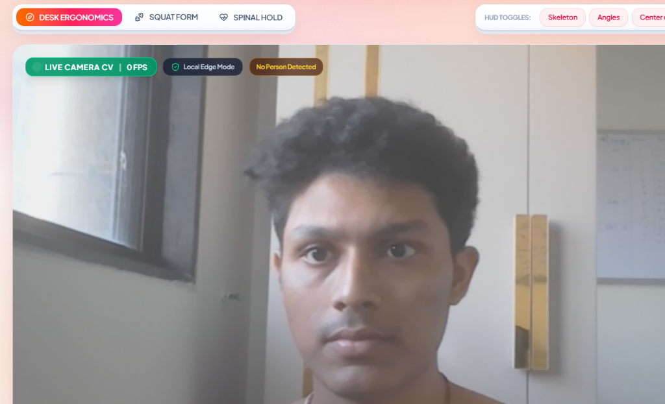
LIVE SYSTEM DEMONSTRATION & SENSOR HUD
Real-Time 30 FPS Optical Inference • 33-Point 3D Skeletal Overlay • Biomechanical Angle Gauges
COMPUTER VISION HUD CAPABILITIES
Live Optical Telemetry
• Sub-Millisecond Anatomical Tracking: Continuous 33-point landmark tracking calculating 3D spatial vectors without specialized wearable sensors.
• Real-Time Joint Angle Badges: Dynamic overlays computing Cervical Pitch (<15°), Acromion Shoulder Balance (<3°), and Lumbar Torso Vector (<7°).
• Center of Mass (CoM) Reticle: Visual crosshair tracking upper-body gravity center; flags anterior slouching before muscle fatigue sets in.
• Bilateral Pelvic Symmetry: Quantifies Left/Right weight distribution (e.g. 52% L / 48% R) to prevent unilateral spinal torque.
• Multi-Movement Engine: Includes Squat Movement Depth tracker with active phase detection and rep counting for active work breaks.
LIVE CAMERA CV // USER LOCKED (30+ FPS) // REAL-TIME SKELETON & CENTER OF MASS RETICLE

Slide 10
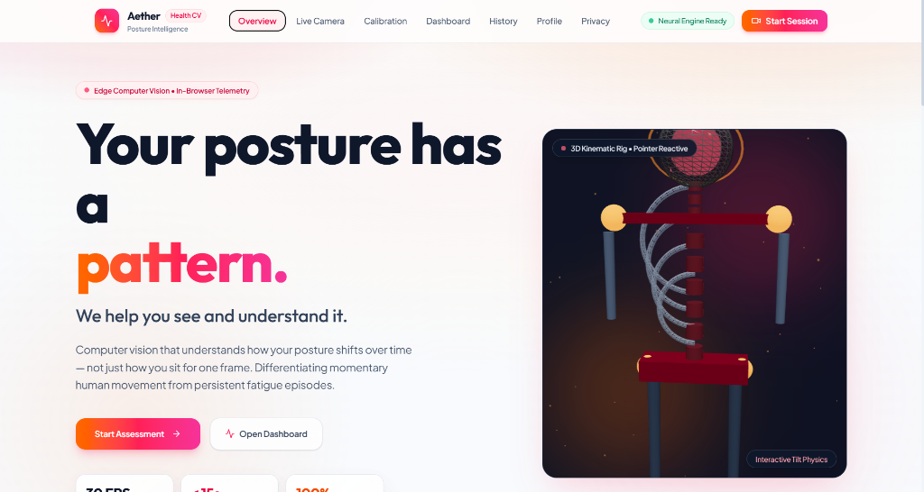
CLINICAL RESCUE RITUAL & ERGONOMIC AUDIT
Interactive Spinal Decompression • OSHA & RULA Compliant Clinical Audit Export
ACTIVE CLINICAL INTERVENTION
15s Spinal Reset Ritual
• Phase 1: Cervical Retraction (15-10s): Deep diaphragmatic inhale combined with deliberate chin retraction to align auditory canal directly over acromion shoulders.
• Phase 2: Scapular Release (10-5s): Controlled scapular depression and retraction, opening the thoracic cavity and alleviating trapezius spasm.
• Phase 3: Spinal Lengthening (5-0s): Axial decompression imaging an upward axial vector through the skull vertex, decompressing lumbar discs.
• Harmonic Acoustic Chimes: Frequency-modulating sine waves synthesize soothing auditory cues signaling phase transitions.
• Gamified Recovery Incentive: Awards +25 Ergonomic Recovery Score and immediately clears active strain episode flags upon ritual completion.
OSHA & RULA COMPLIANT CLINICAL AUDIT REPORT (1-CLICK PRINT / PDF EXPORT)
• Rapid Upper Limb Assessment (RULA Action Levels 1-4) analyzing cumulative cervical load time.
• Quantified anatomical breakdown and actionable workstation prescriptions (monitor riser height, forearm geometry).
• Ready for physiotherapist consultations, orthopedic visits, and corporate health insurance wellness claims.

Slide 11
IMPACT & BENEFIT
IMPACT
FEASIBILITY
Target: improve posture awareness and reduce unnoticed poor-posture periods during desk work.
Browser + webcam approach keeps setup simple. Users can interact with feedback while continuing normal tasks.
FUTURE SCOPE
RISKS & MITIGATION
Lighting / camera angle → setup guidance. False alerts → adjustable thresholds. Privacy concerns → minimize data retention.
Personalized posture profiles, session analytics, break reminders, additional posture patterns, and progress tracking.

Slide 12
FUTURE IMPLEMENTATION & SCALABILITY ROADMAP
From Browser Intelligence to Enterprise Musculoskeletal Health Ecosystem
PHASE 1 // Q4 2026
Smart Desk & IoT Actuation
• Matter / BLE Protocol: Seamless pairing with motorized standing desks (IKEA, Autonomous, Uplift).
• Autonomous Height Shifts: Automatically raises desk to standing height after 45 minutes of static seated slouching.
• Haptic Chair Feedback: Gentle vibration pulses embedded in lumbar chair cushions for silent physical prompts.
PHASE 2 // Q1 2027
Wearable Sensor Fusion
• Apple Watch / WearOS Sync: Continuous background accelerometer & gyroscope streaming from smartwatches.
• Multi-Axis Pose Validation: Maintains accurate spinal curvature analysis even when user turns 90° away from webcam.
• Heart Rate Variability (HRV): Correlates postural slump with sympathetic nervous system fatigue and cognitive load.
PHASE 3 // Q2 2027
B2B Enterprise Health Hub
• Anonymized Corporate Analytics: Enterprise HR dashboards tracking aggregate musculoskeletal health across remote teams.
• Insurance Rebate Integration: Partnerships with health insurers offering verified posture wellness premium discounts.
• Ergonomic Equipment Audits: Data-driven hardware recommendations (ergonomic chairs, monitor arms) based on team metrics.
PHASE 4 // Q3 2027
AI Predictive Spine Twin
• Spinal Digital Twin: 3D biomechanical modeling projecting long-term disc compression and cervical wear over 5-year horizons.
• Preemptive Injury Forecasting: Identifies early asymmetric compensation patterns preceding chronic sciatica or carpal tunnel.
• Prescriptive Physical Therapy: Auto-generates tailored physical therapy exercise prescriptions verified by orthopedic specialists.

Slide 13
REFERENCE & CONCLUSION
REFERENCES / FURTHER READING
FINAL WRAP-UP
• MediaPipe documentation – Pose Landmarker / pose estimation
• TensorFlow.js documentation – machine learning in the browser
• React documentation – component-based user interfaces
• World Health Organization – musculoskeletal health resources
AlignMe addresses an everyday problem: poor posture that goes unnoticed during long desk sessions.
By combining continuous posture awareness with immediate feedback, the project aims to help users recognize and correct posture before poor habits become routine.
ALIGNME
L

